Slide 1

CNN Spatial
Optimizations
CRML Lab
The Technion
Inna Batenkov
Ido Imanuel
Gil Shomron

Slide 2

Project Goals
Acquire knowledge on CNNs
Build an end-to-end framework for
Cross Neuron Predictions
Develop a prediction mask optimization
scheme
Analyze MAC operation savings on various
networks and datasets

Slide 3
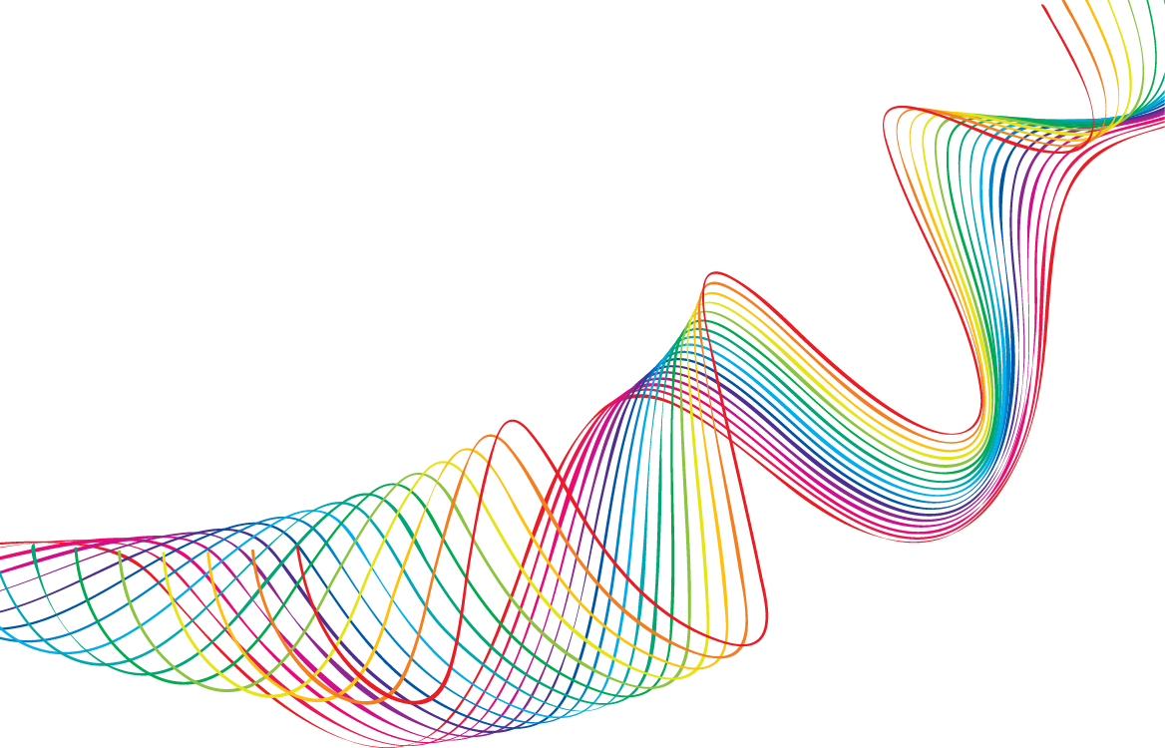
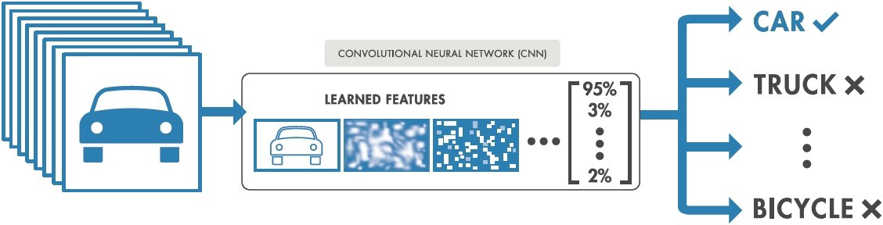
Convolution Nets

Slide 4

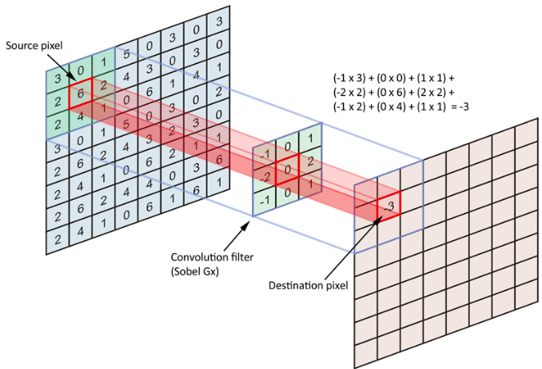
Convolution Nets

Slide 5
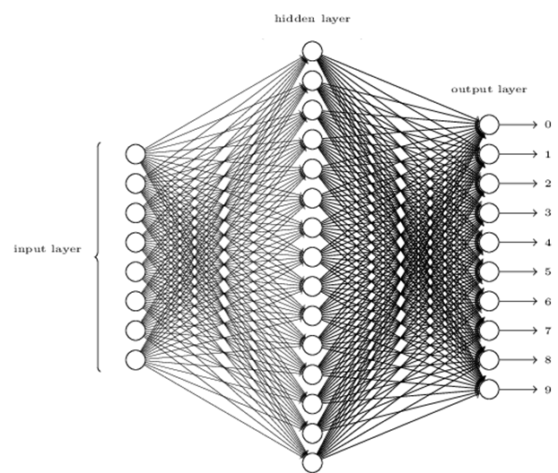

Net Collaterals

Slide 6
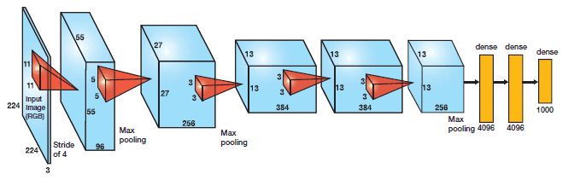
AlexNet - 2012

Slide 7

Power Considerations in CNNs
Can we make Machine Learning portable to battery powered mobile devices?
Notes:
(1) Smaller DNNs require less communication across servers during distributed training.
(2) Smaller DNNs require less bandwidth to export a new model from the cloud to an autonomous car.
(3) Smaller DNNs are more feasible to deploy on FPGAs and other hardware with limited memory.

Slide 8
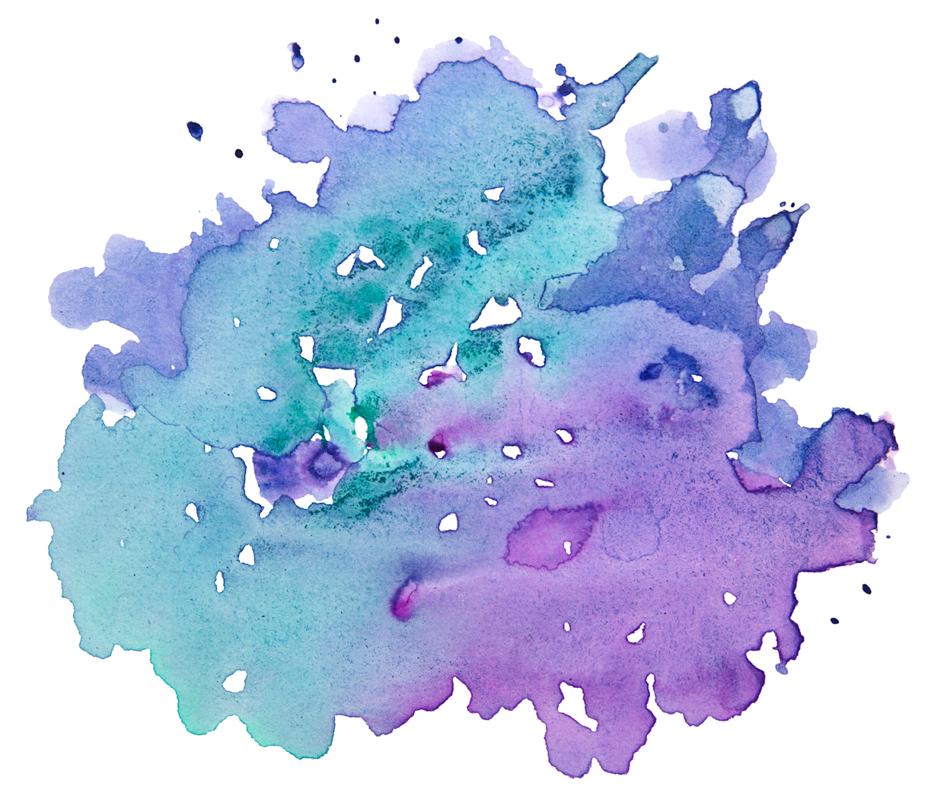
This work:
More than 25% of all MAC operations are redundant
Can we utilize this to save power?
Notes:
AlexNet, Cifar10

Slide 9

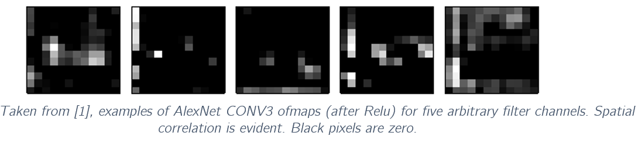

Core Ideas
Relu is common: Due to its relative simplicity and fast convergence rate, Relu is currently the most popular activation method
Spatial Correlation: There is heavy correlation between nearby pixels
Non-positive convolution values turn zeros: Relu thresholds any negative values to 0

Slide 10
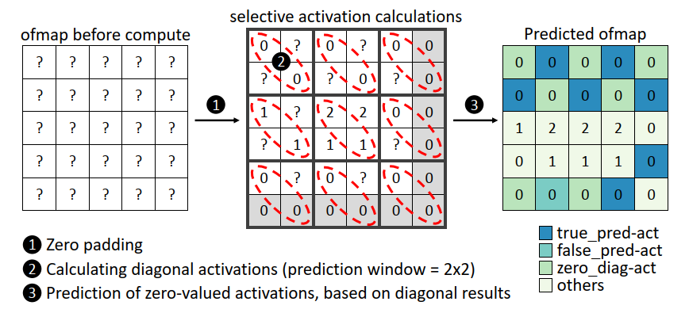
Cross Neuron Predictions
The Good:
For a good prediction, we save as many MAC operations as there are zeros in the prediction mask
The Bad: Bad predictions may degrade classification accuracy

Slide 11
Optimizing Prediction masks

Slide 12
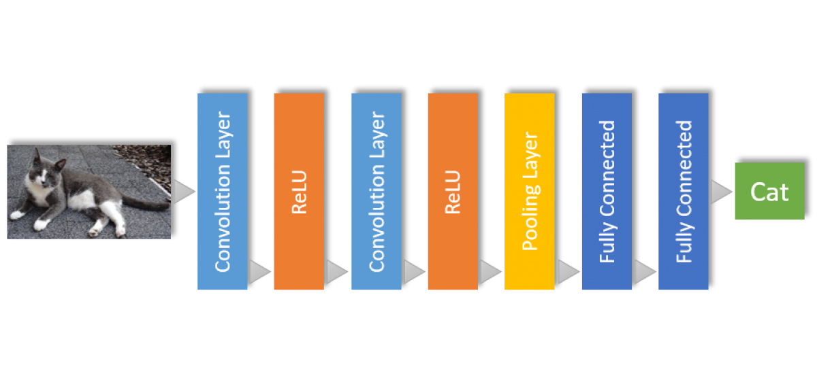

CNP Simulations
Utilizing PyTorch Layers: We create a custom “Spatial” layer, responsible for collecting MAC operation statistics with each forward run of the CNN. These layers are placed after Conv & Relu layers
Spatial
Spatial

Slide 13
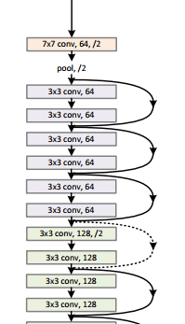

CNP Simulations
Generalizing to other architectures: We allow generalization of CNP testing to any network architecture with the SpatialNet class family, and implement for AlexNet, ResNet18, ResNet34 and VGG16

Slide 14
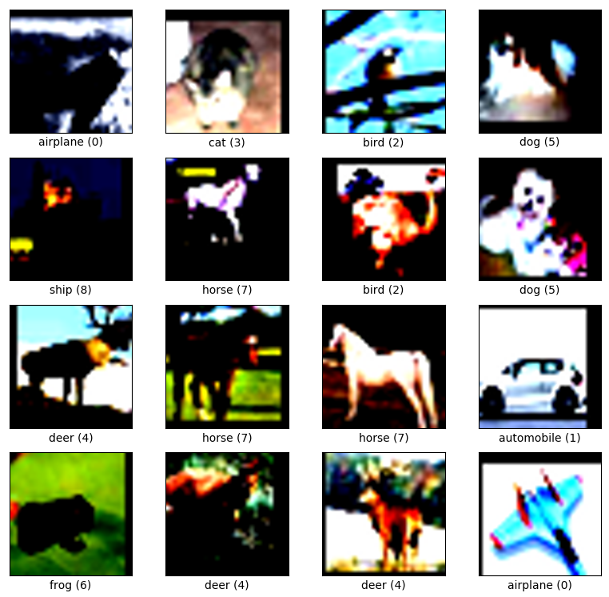
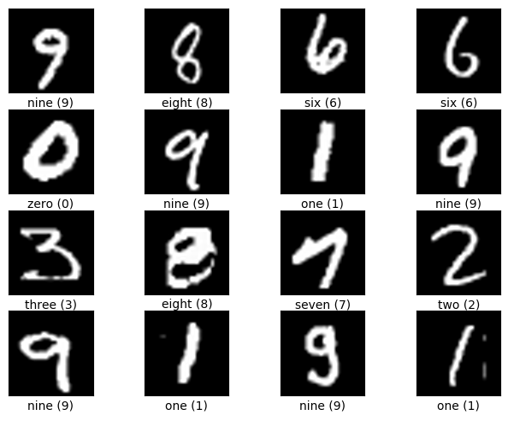
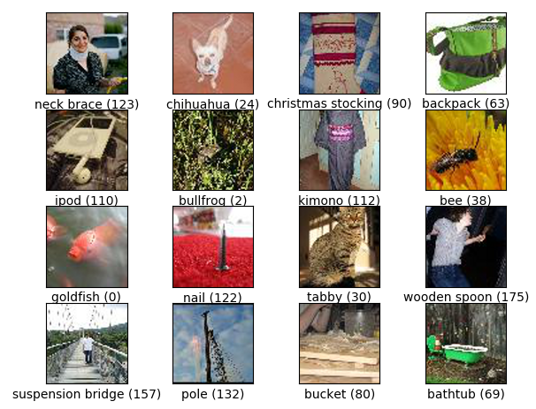
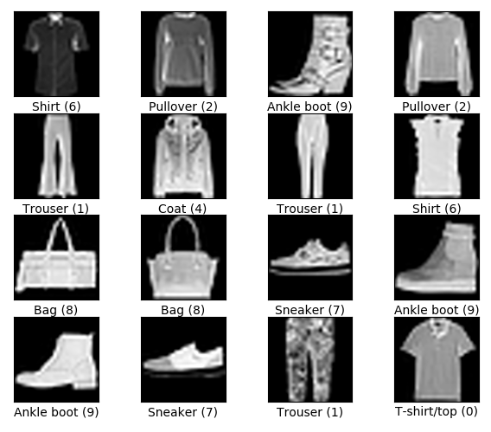
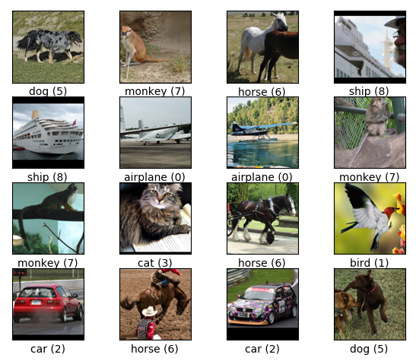
CNP Simulations
Dataset Generality: Input layers and Fully connected layers are tailored to a specific dataset. We embed flexibility in the network build phase, allowing for testing on any dataset chosen
CIFAR10,
32x32 RGB
MNIST,
28x28 Grey
ImgNet,
256x256 RGB
FashionMNIST,
28x28 Grey
STL10,
96x96 RGB

Slide 15
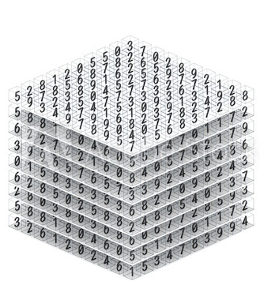
Optimization Troubles
Given an input of size 227x227, first layer of the AlexNet architecture has 96 filters of size 11x11.
This creates a 96x55x55 ofmap, which will then be inserted into the Spatial layer.
Choosing a patch size of 2x2, need to split this map into 2x2 blocks. We therefore pad the map with a section of zeros, resulting in an ofmap of size 96x56x56. We can now insert N different patches
We now have different mask configurations to choose from, making this problem incomputable and most likely, NP-Hard
Example of an output feature map
(ofmap)
Notes:
And this is only for the first layer

Slide 16
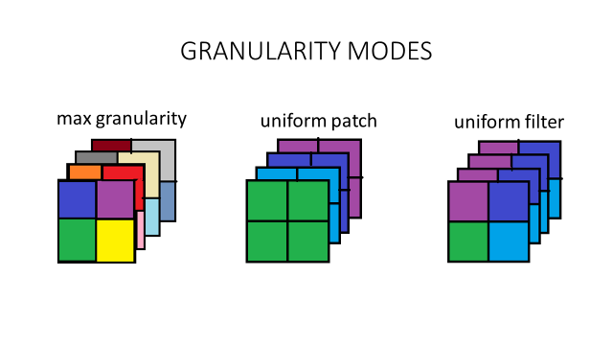
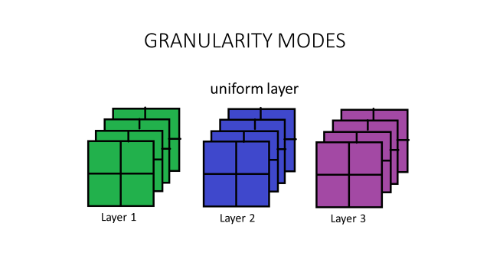
Greedy Optimization
We devise a Greedy optimization scheme, running in 4 modes of Granularity

